Slide 1











Next-Generation Refactoring: Combining LLM Insights and IDE Capabilities for Extract Method
Danny Dig
Dorin
Pomian
Abhiram
Bellur
Egor
Bogomolov
Timofey Bryksin
Malinda
Dilhara
Zarina
Kurbatova
Andrey
Sokolov
Notes:
Hi! I'm excited to present our work, which combined the creative power of LLMs along with the safe refactoring capabilities of IDEs.
Work done in collaboration with other students in our group, Jetbrains Research + PhD advisor Danny Dig.
I want to model for you how to do a paper presentation. You all read the paper so I will not present everything in the paper. Instead, I will present supplemental information that will help us understand the bigger context of the problem being solved. In particular, I will give a couple of demos of the tools mentioned in this paper.

Slide 2

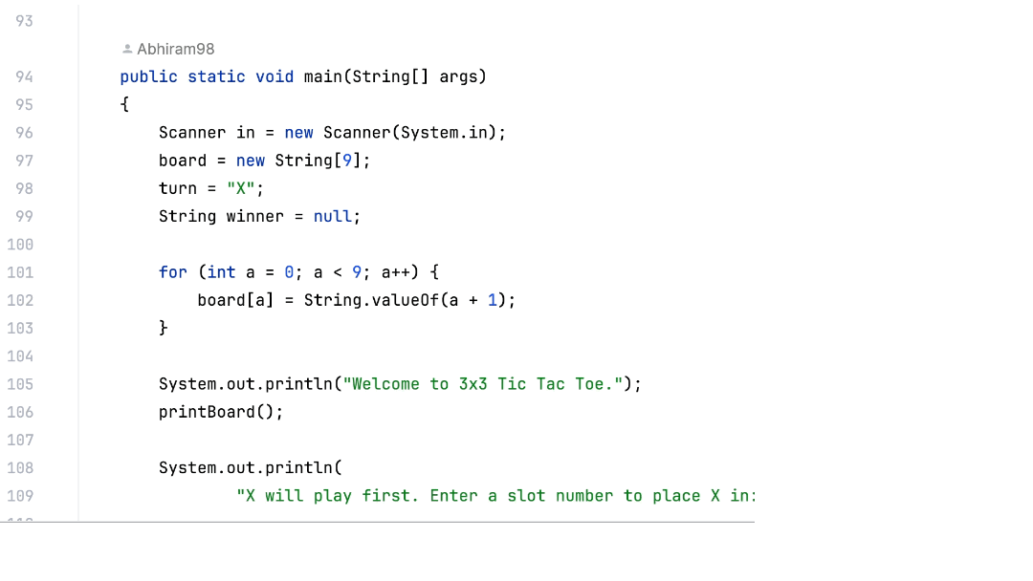

Long Methods In Codebases
Notes:
Long Methods refers to methods that have grown too large
Often perform multiple tasks
They are considered an anti-pattern
Reduced readability
Higher maintenance cost
Decreased reusability
Difficult to test
Prone to bugs
Significant source of technical debt
Long methods refers to methods (or functions) that have grown too large over time. They often perform multiple tasks, and they are considered an anti-pattern in software engineering.
Some problems that Long Methods introduce are: reduced readability, higher maintenance cost, and decreased reusability. Long methods are difficult to test, they are prone to bugs, and they represent a significant source of technical debt.

Slide 3
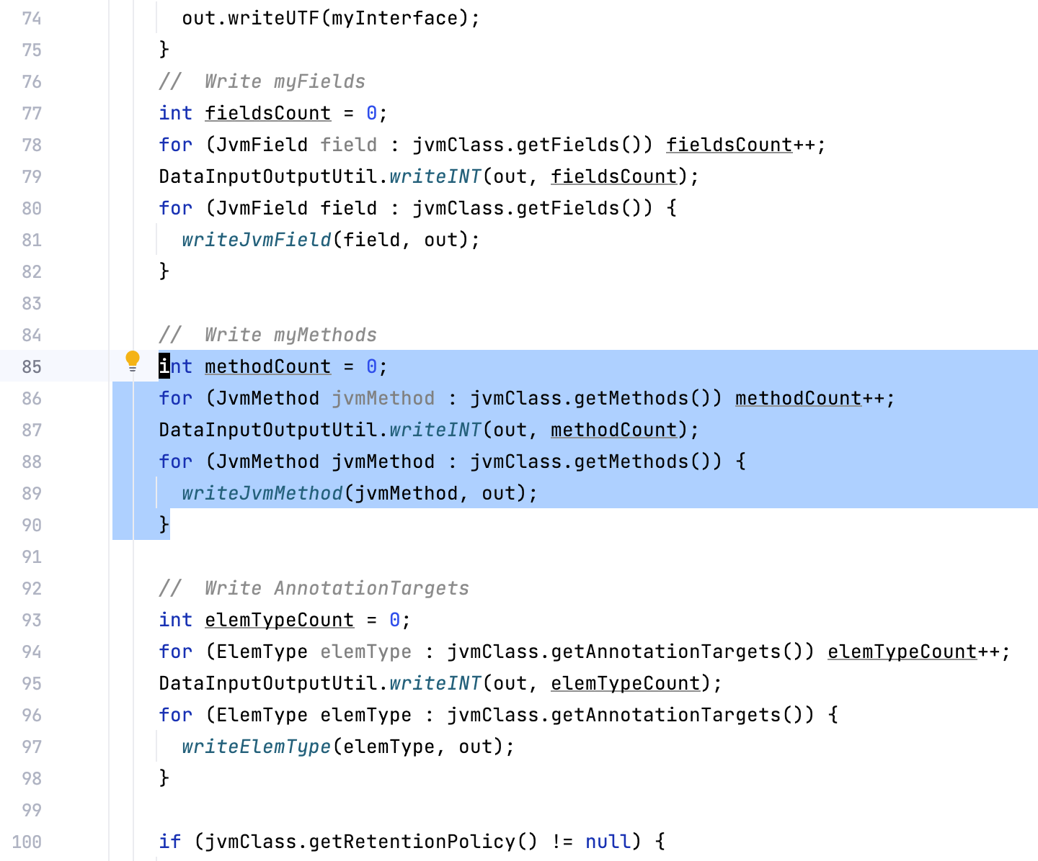
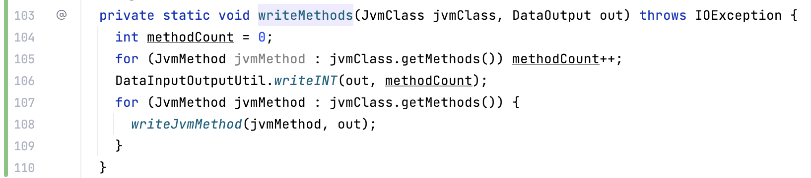
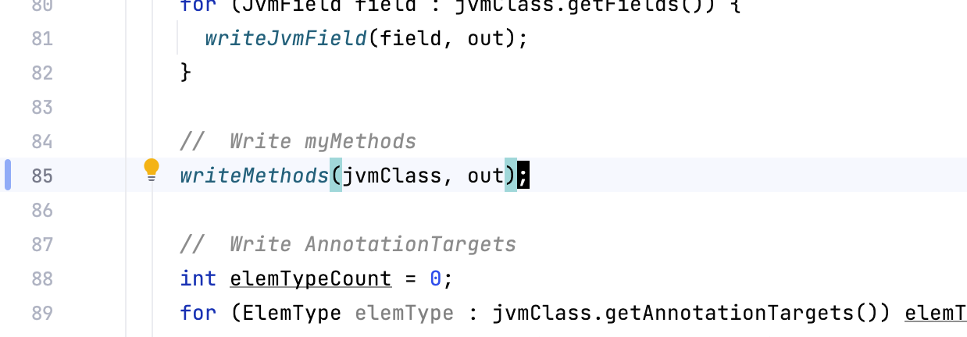





Extract Method Refactoring
2. Extracted Method
1. Original Method
3. Call Site
Notes:
The solution to dealing with long methods is to split them up into smaller ones.
"Extract Method" is one of the most common refactoring techniques used to address the issue of Long Methods. The idea is to take a code fragment from a long method and turn it into a new, separate method, replacing that code fragment with a call to the newly extracted method.
Staple refactoring supported in all modern IDEs.
Let’s see how its done in IJ.

Slide 4
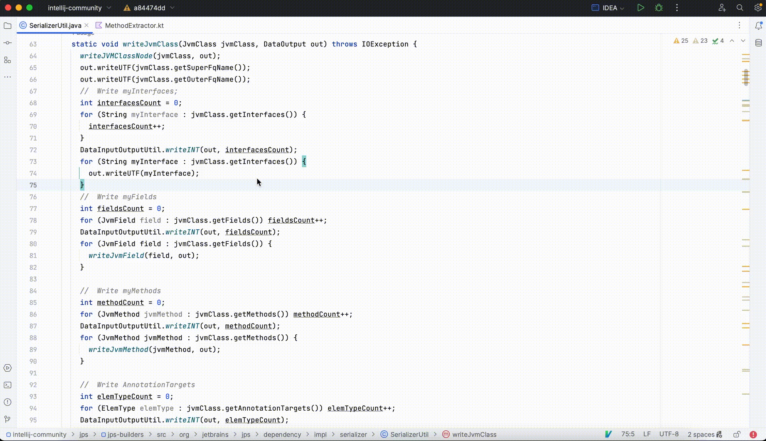


Current Extract Method Workflow in IntelliJ
JetBrains’ IntelliJ IDEA has extract method capabilities
Semi-automated process
No automatic recommendations
Notes:
Modern IDEs, such as JetBrains’ IntelliJ IDEA, have extract method capabilities. However, this is a manual process, in which the developer has to manually select the code fragment to be extracted in a new method. There are no automatic recommendations.
No automatic recos for statements that go together, nor is there a recommendation for a meaningful name for the newly extracted method.

Slide 5
Extract Method Research
Many research tools for recommending fragments to extract
JDeodorant
JExtract
LiveREF
REMS
GEMS
SEMI
?
Optimize software quality metrics
Generate refactorings that do not align with developers’ preferences
Notes:
Choosing which statements are profitable to extract has been the subject of many research tools that employ hard-coded rules to optimize software quality metrics. Despite steady improvements, these tools often fail to generate refactorings that align with developers’ preferences and acceptance criteria.
Developers rely on their understanding of software engineering principles and their subjective interpretation of code context when deciding what makes a good method EMPHASIZE
We posit that the decision what to refactor and how is both a science and an art. Developers use both their knowledge of software engineering principles, and rely on their own experience and subjective interpretation of the code context and what makes a good method. This might explain why developers are reluctant to use automated refactorings [14] and the large gap between high metrics scores and their low acceptance by developers
Coupling, cohesion: science. Art – their expertise.

Slide 6
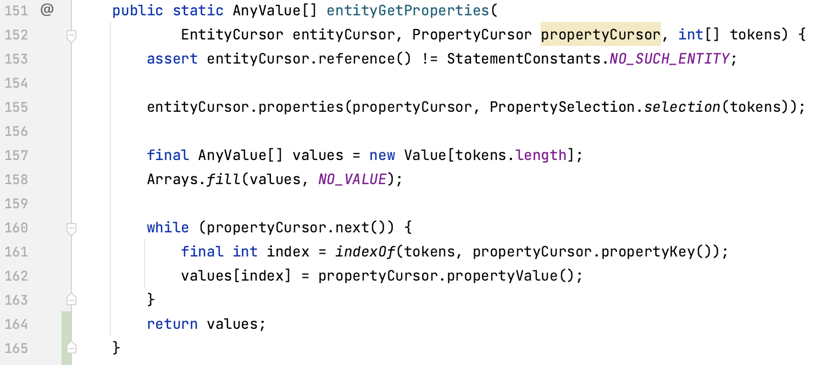



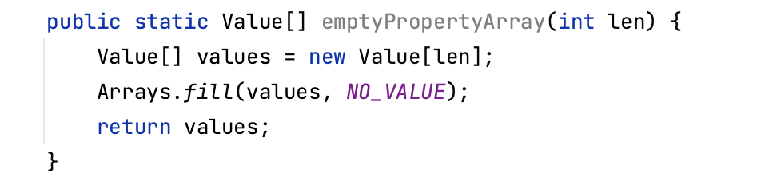
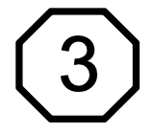
Motivating Example from Open-Source Project (Neo4j)
a05a8c5
Intuition: LLM Suggestions – align with developer preferences
LLM Hallucination – Not Useful
OSS Developer
Wow – LLM!
Other Tools
LLM Hallucination
- Invalid
Notes:
Replicate this
So, our intuition was to use LLMs – whose suggestions align with developer preferences, as they have been trained on a massive amount of coding data.
Here is an example, from an open source project, which highlights both the strengths and weakness of the LLM
CLICK
Actual refactoring - Developer extracted LOC in box 1;
Amazingly, LLM also gives precisely this recommendation
Let’s replicate this scenario with other tools.
Compute program slice, try to maximise it. It’s not wrong but its not what the developer did.
Box 2 – predictions from static analysis tools. Mixes multiple responsibilities – do not align with the way developers extract code
Initialise array + perform computation
However, LLMs also suggested to extract box 3 – this is a hallucination impossible to extract such a code, from the middle of a loop
Box 4 – single line extractions, which developers prefer not to do.
Function initiliases an array – it performs only one operation, and can be reused.

Slide 7

Our solution: LLM + IDE Static Analysis
Leverage creative capabilities of LLMs
Use static analysis techniques to filter, further enhance, an rank LLM-provided suggestions
Utilize the full power of a state-of-the-practice commercial IDE, IntelliJ IDEA, to apply refactorings safely
IntelliJ IDEA plugin implementation – EM-Assist
+
Notes:
EM-Assist synergistically combines
(i) the creative capabilities of LLMs,
(ii) static analysis techniques to filter and enhance LLM-provided suggestions, and
(iii) the full power of a state-of-the-practice commercial IDE to apply refactorings safely.
Our tool, EM-Assist, is implemented as an IntelliJ IDEA plugin. It leverages the creative capabilities of LLMs. Starting from candidates suggested by LLMs, EM-Assist filters, further enhances (e.g. corrects code fragment’s scope), and then ranks the suggestions based on static analysis techniques from program slicing.
To ensure that Extract Method is performed safely and correctly, EM-Assist utilizes the full power of state-of-the-practice commercial IDE, IntelliJ IDEA.

Slide 8

EM-Assist Workflow

Slide 9


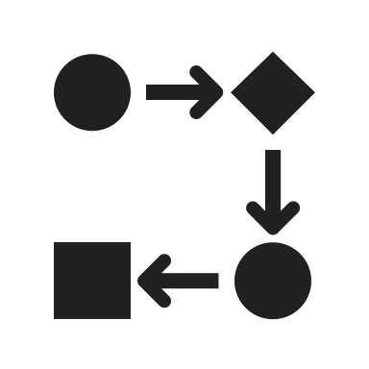


Empirical Evaluation
Datasets:
• Synthetic Corpus of 122 scenarios
• Mined 1752 real-world Extract-Method refactorings from OSS
RQ1: How effective is Vanilla LLM?
RQ2: What LLM hyper-parameters work best?
RQ3: How effective is EM-Assist?
RQ4: How useful is EM-Assist?

Slide 10
RQ1: How effective is Vanilla LLM?
Asked an LLM to replicate an oracle of refactoring situations
LLMs are creative and prolific: averaging 27 suggestions per method
Hallucination Invalid - 44.4% of the suggestions are invalid, resulting in non-compiling code, or semantically not equivalent
Hallucination Not Useful - 14.8% of suggestions are not useful (e.g. one liners, or entire method body)
Notes:
Our intuition is that given the fact that Large Language Models (LLMs) have been trained on large code corpora, they are more likely to imitate human behavior. If we harness the familiarity of LLMs with the way developers form methods, we could suggest refactorings that developers are likely to accept.
Our experiment on more than 2thousand 8hundred real-life methods from open source projects in which developers performed Extract Method refactoring, reveals that
LLMs are creative and prolific, generating more than 12thousand 3hundred Extract Method suggestions, averaging 4 suggestions per method.
However, more than 44% of these suggestions are invalid, potentially resulting in non-compiling code
And almost 15% were not useful (for example one liners or entire method body)

Slide 11
RQ3: How effective is EM-Assist
Oracle of actual 1752 extract method refactorings from OSS
EM-Assist achieved 53.4% recall rate
Compared to 39.4% recall rate by JExtract (best in class using static analysis)
EM-Assist better aligns with how expert developers performed refactorings in the wild.
Notes:
Previous best in class.
Introduce metric – recall.
To evaluate EM-Assist we performed an automatic evaluation on two corpora.
On an extended corpus of 16hundred ExtractMethod refactorings actually applied by open-source developers in modern codebases, EM-Assist achieved a recall rate of 49%, compared to 23% for the previous best-in-class tool that relies solely on static analysis. This *dramatic* improvement shows that EM-Assist better aligns with how developers refactor their code.
We did a usability survey with 18 professional developers from industry and these were the results:
They really liked the tool: 94% gave a positive rating. These were the comments:
show more results in paper. Hope you read paper. Compared with other tools 5 other tools benchmark. <backup slide with synthetic corpus, and why we created this corpus>
MESSAGE ; em-assist
<Read quote at bottom>

Slide 12

RQ4: How useful is EM-Assist?
Fire-house survey – New commits
16 expert developers participated in the survey, with 81.3% giving a positive rating
“It looks super cool so far! :fire:”
“Thank you for interesting suggestions! Hope to see this in production in the future.”
“These suggestions made me look at this code with new eyes, and I will try to refactor it”
Notes:
Real experts, offer recommendations on their own code.
Most qualified to judge quality of suggestions
Experienced, expert developers from a leading software company
Summarise reasons for disagreement
Complicate code organization – prefer to have a linear flow
Too many parameters.
The extracted method does not promote reuse

Slide 13
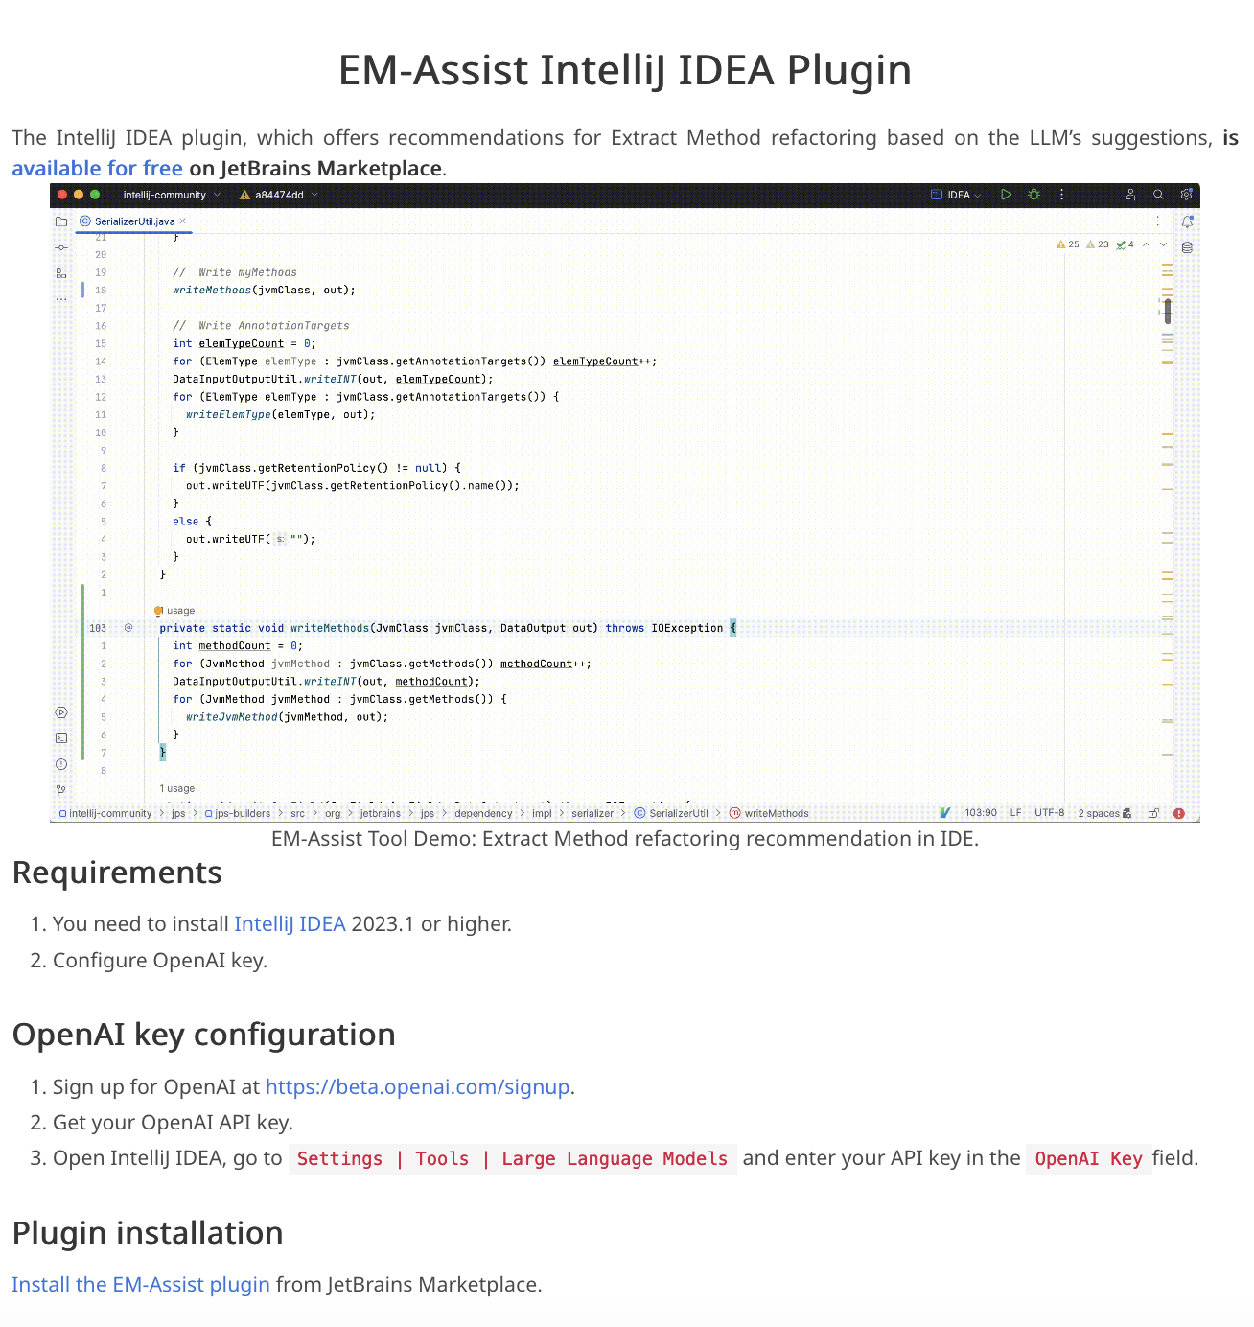

Executive Summary
LLM’s create a wow effects,
but also have a high hallucination rate – 59.2%
Tame Hallucinations
Tame the non-determinism
EM-Assist outperforms previous state-of-the-art and aligns with how expert developers perform refactoring.
IDE + LLM + Human >> Sum of the individual parts
Ongoing work: Moving beyond one refactoring at a time ⇒ Refactoring Plan executed by an Agent
Tool, Datasets

Slide 14

Demo
Notes:
Let’s see EM-Assist in action on Java code.
EM-Assist is implemented as an intention action. To trigger it, the cursor needs to be anywhere inside a method. Then, we right click and we select “Show Context Actions” . From the next menu, we select “Extract Method Suggestions”.
What happens under the hood is that EM-Assist selects the entire code of the method and prompts our LLM of choice, in this case GPT3.5 turbo, for Extract Method suggestions. A progress bar here at the bottom indicates this.
EM-Assist then further enhance, filter out invalid suggestions or those that could potentially result in non-compiling code, and ranks the rest of suggestions, displaying the remaining top 3 to the user.
For display, we use this popup window in which we show the length of the suggestion, the proposed method name and the method signature.
The developer then can inspect these suggestions, and they select the one that is the most suitable. Note that the corresponding code is highlighted with a purple hue in the main editor pane.
To actually perform the code transformation, the developer clicks on the Extract button. The code fragment is replaced with a call to the new method, and down below we have the extracted method itself.
Wiggle cursor as you talk.
Also mention the purple color - look in the ICSE paper for phrasing.
After extracting the method, show the definition of the method. “This is how it works in Java”
Transition to Kotlin is too fast

Slide 15
Your questions: Suggestion Quality, Ranking, and Human Factors
How does the system reconcile objective software engineering best practices with subjective developer preferences, particularly when its definition of "usefulness" risks reinforcing existing patterns at the expense of novel solutions?
Does the ranking mechanism inherently down-rank rare but superior refactorings, and have alternative presentations—like grouping by intent or removing ranks entirely—been explored to counter this bias and better empower developers?

Slide 16
Ensuring Correctness and Handling Hallucinations
Beyond the limits of static analysis, how does the system guarantee that a refactoring suggestion is semantically equivalent and preserves control flow, thereby catching subtle hallucinations?
How does it differentiate these errors from intentional, beneficial logic changes a developer might want, and what are the performance and feasibility trade-offs of integrating a deeper analysis tool, such as a language server, into the validation pipeline?

Slide 17
LLM Behavior, Prompting, and Configuration
What explains the counterintuitive result of GPT-3.5 outperforming GPT-4 for this task, and how sensitive is the system to future model updates?
In controlling the output, what are the trade-offs between constraining the model via prompt engineering versus applying post-processing filters?
How is the model's non-determinism managed, and could it be leveraged as a feature—using higher temperatures to generate more diverse, semantically equivalent suggestions for the developer to choose from?

Slide 18
Scalability, Generalization, and Long-Term Impact
How does this tool's performance scale to massive enterprise codebases with significant legacy code?
What is its measurable long-term impact on code maintainability and potential runtime performance?
What strategies can make the associated LLM costs economically viable for smaller businesses?

Slide 19
System Architecture and Adaptation
From an architectural standpoint, how does the IDE integration manage asynchronous calls to maintain UI responsiveness, and could different IDE versions improve performance?
Can the system adapt beyond one-shot suggestions to learn and enforce project-specific coding conventions by retaining context over time?
How do its heuristics, such as the 88% filter, balance the goal of eliminating trivial suggestions against the risk of accidentally discarding valid, large-scale refactorings?

Slide 20
RQ2: What LLM hyper-parameters work best?
How is Recall effected by various LLM hyper-parameters?
Recall: Do we match what the developer did?
Hyper-parameters:
Temperature – Randomness of LLM
Iterations – Repeating the same prompt
Notes:
SKIP if running out of time.
<Say a little bit about what we play with>
Higher temperatures, … <copy from em-assist>… lower temperatures <copy sentence> deterministic.
Iterations – Non deterministic. Repeating the same prompt. Connect with ND

Slide 21
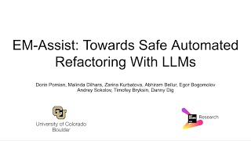
Demo: EM-Assist

Slide 22
RQ1: Vanilla LLM Comparison

Slide 23
Prompt
You are a skilled software developer. You have immense knowledge on software refactoring.
You communicate with a remote server that sends you code of functions (one function in a message) that it wants to simplify by applying extract method refactoring.
In return, you send a JSON object with suggestions of helpful extract method refactorings. It is important for suggestions to not contain the entire function body.
Each suggestion consists of the start line, end line, and name for the extracted function.
The JSON should have the following format: [{"function_name": <new function name>, "line_start": <line start>, "line_end": <line end>}, ..., ].
Example 1 :
280. public void connect(Figure figure) {
281. if (fObservedFigure != null)
282. fObservedFigure.removeFigureChangeListener(this);
283.
284. fObservedFigure = figure;
285. fLocator = new OffsetLocator(figure.connectedTextLocator(this));
286. fObservedFigure.addFigureChangeListener(this);
287. if (fLocator != null) {
288. Point p = fLocator.locate(fObservedFigure);
289. p.x -= size().width/2 + fOriginX;
290. p.y -= size().height/2 + fOriginY;
291.
292. if (p.x != 0 || p.y != 0) {
293. willChange();
294. basicMoveBy(p.x, p.y);
295. changed();
296. }
297. }
298. }
Example Response 1:
[
{
"function_name": "updateLocator",
"line_start": 288,
"line_end": 296
}
]

Slide 24
Ablation Study

Slide 25
Cost of Invoking LLM
For 100LOC(~1000 tokens) it is ~$0.01
Some IDEs/services bundle all LLM invocations for a fixed cost ($10/month).
EM-Assist is fast enough to be used in-IDE interactively
around 2sec response/iteration - iterations can be run in parallel

Slide 26
Motivating Example
2. Extracted Method
1. Original Method
3. Call Site
Notes:
Let’s consider the following motivating example. We can observe that there are several functionalities in the original method, and they are delimited by a comment line: write myFields, write myMethods, annotationTargets, and so on.
All these small code fragments could be potentially extracted in a new, smaller and more manageable methods. In Fig 2 we can see how the extracted method looks like, and in Fig 3 we can see how the original method was refactored such that the highlighted code fragment was replaced with a call to the new method.

Slide 27
What is refactoring?
Controlled technique for improving the design of an existing code base [Martin Fowler - Refactoring]
The process of restructuring existing code without changing its external behavior
Benefits
Promotes software design best practices
Reduce technical debt
Cost efficiency in the long run
Notes:
Script:
What is refactoring? As Martin Fowler said in his book, refactoring is a “Controlled technique for improving the design of an existing code base”.
It is the process of restructuring existing code without changing its external behavior.
The benefits of refactoring, in general, include, but they are not limited to promoting software design best practices, the usage of design patterns,
Reducing the technical debt, and increasing cost efficiency in the long run.

